Slide 1
Digital transformation in the society: how to safeguard rights and freedoms?
HILLE HINSBERG
www.proudengineers.com

Slide 2
How is the story of transforming Estonia into digital society connected with democracy and civic rights?
Are words like involvement, trust and accountability becoming obsolete or can they be part of the design?
What is the role of governments, civil society organizations and citizens in the digitalized world?

Slide 3
7 Principles of Digital Society
Internet Everywhere
Strong Digital Identity
Data Interoperability
Trust
Privacy and Protection
No Legacy
Continuous Amusement
Notes:
Principles are universal

Slide 4
Universal Internet Access
Connectivity is not a convenience, but a necessity.
Digital services versus digital interaction and participation: how to grant safe access?
Digital life presents challenges for human rights and democratic governance – Freedom on The Net: democratic governments have an obligation to craft regulations that enable users to express themselves freely, share information across borders, and hold the powerful to account.

Slide 5
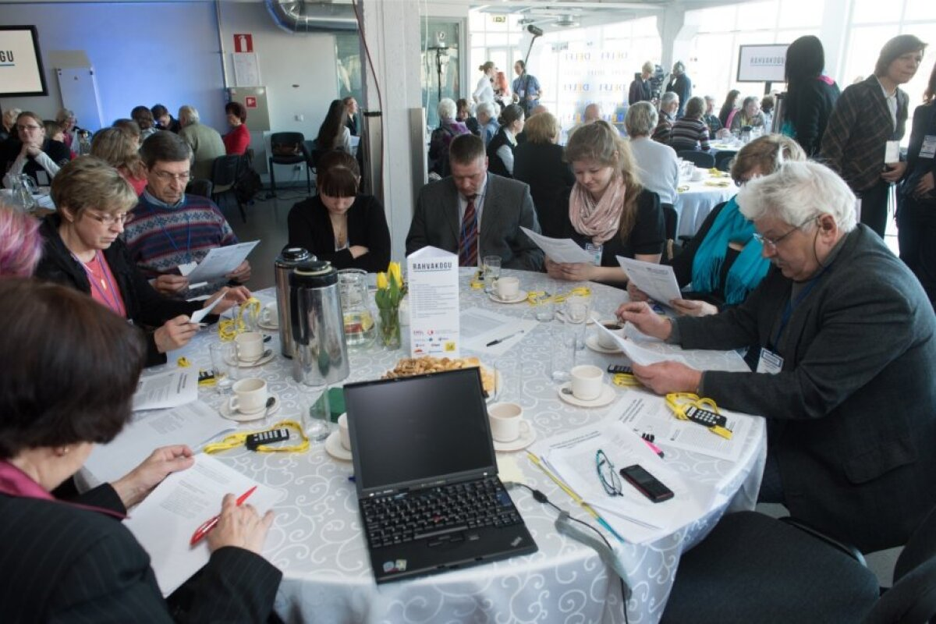
Strong Digital Identity
Digital hygiene: ensure that people can authenticate themselves in a convenient manner when using digital services.
Citizens need to access public and private services in the same way to establish their ownership of their data.
Civic activism: how to onboard and protect platform users?
The story of Citizen assembly

Slide 6
Data exchange AND trust
Infrastructure and incentives are needed for government agencies as well as businesses to securely share data. This enables services to be automated, and better use of public data for innovation.
Efficiency and keeping promises creates trust.
Civic tech can build social capital and call for accountability – Citizen.os

Slide 7
Privacy and protection
People should know who has access to their data and have a way to control this (data tracker)
Agreeing on data management standards across government. Ensure access to open data and its re-use for public benefit.
Accountability of algorithms. Transparency mechanisms can provide information about algorithmic systems to the general public

Slide 8
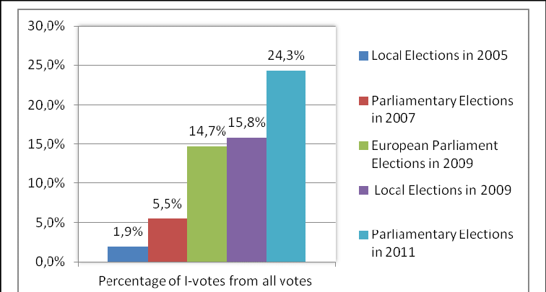
Continuous amusement
People should constantly see new features and ideas to keep them engaged and demanding more. I-voting!
Estonia offers a testing environment, Digital Testbed Framework to develop and validate proof-of-concepts with the access to e-government solutions and technology. The solutions will be made available in Estonian open source code repository.

Slide 9
Some ideas and suggestions
Make it clear who is behind the device. Create and use electronic authentication and signature solutions to safeguard activism
Take control of your own data. Make better use of the data that you already have.
Governments are pushing AI, biometric surveillance, and big-data tools. This needs to be balanced by transparency, independent oversight, and redress procedures.
Experiment and tolerate the failure. Innovation sandboxes allow to test solutions even for the most complicated issues.

Slide 10
Let´s build the digital future together!
Hille Hinsberg
Governance expert
hille.hinsberg@proudengineers.com

