Slide 1
Patricia Lucas and Rosa Robinson
WHAT IS DATA POVERTY?

Slide 2
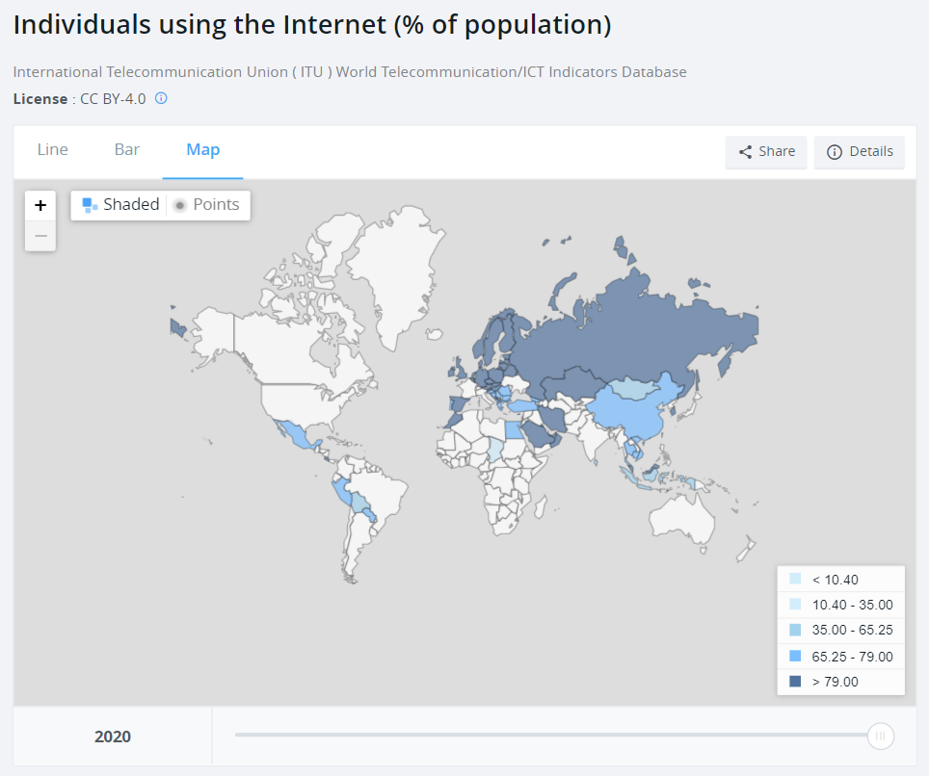
The digital divide is changing

Slide 3
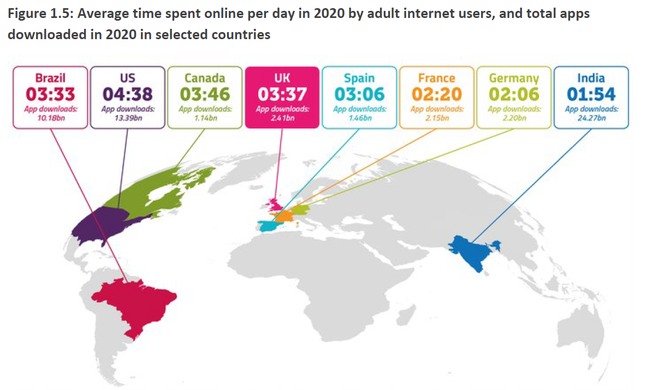
Digital natives and digital migrants dominate
Adult spend an average of 3+ hours online
Internet use widespread across all ages
The divide is now about affordability, usage is lowest in low income groups
https://www.ofcom.org.uk/research-and-data/internet-and-on-demand-research/online-nation
Notes:
Why we need a new definition - emerging understand of digital exclusion about digital natives and digitally informed

Slide 4
What is data poverty?
Unaffordability of broadband connection:
In Scotland, just 40% of those living on lowest income have broadband
In the USA, 48% of those without broadband at home said this was because it was unaffordable
In the UK, Lloyds found that no/low users said the of broadband was a barrier
Going online is more costly for those who lack digital literacy or have poorer purchasing power
Contracts can be difficult to understand, and difficult to access for some
Pay-as-you-go costs are higher than contract costs
Those with low digital skills pay more for their access - Lloyds estimated the lower income/lower engagement groups spend £720 more per year going online than those with similar income but high digital engagement

Slide 5
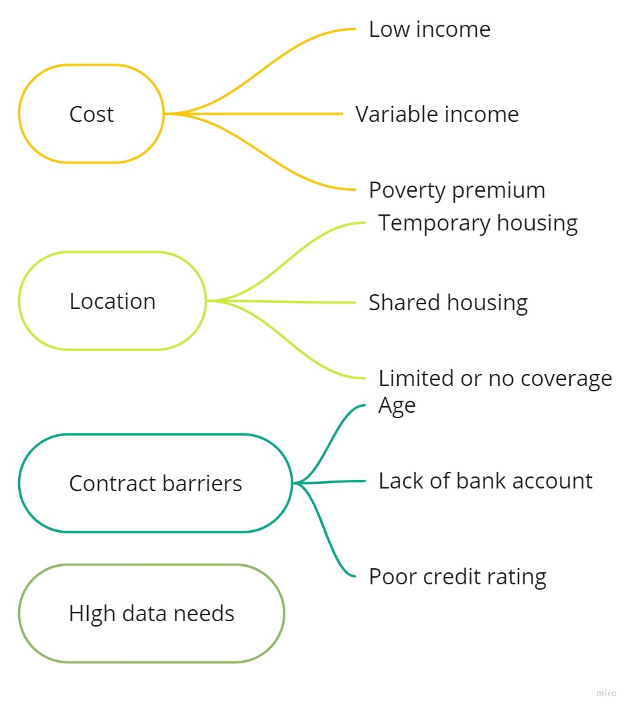
Drivers and dimensions of data poverty
Drivers
Vulnerable groups
Dimensions
Affordability
Choice
Infrastructure
Privacy and security
Quantity
Skills
Usability
Insecure employment
With Disabilities
Refugees
Homeless
Those in education
Remote locations
Domestic Violence
Multiple occupancy housing
Unemployed

Slide 6
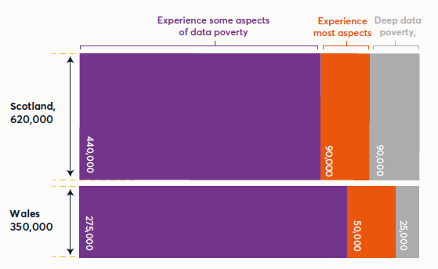
Who experiences data poverty in Scotland and Wales?
“Data poverty is where individuals or households cannot afford sufficient, private, and secure mobile or broadband data to meet their essential needs.”
1 in 7 adults in Scotland and Wales said they experienced data poverty
About 1 in 3 of these experienced most or all aspects of data poverty

Slide 7
What are the impacts of data poverty?
The greater the need for data, the bigger the impact
Data poverty widens existing inequalities and perpetuate deprivation by limiting access to opportunities.
Experiencing data poverty means making hard choices about which bills to prioritise
Notes:
The greater the need for data, the bigger the impact:
Unemployed job seekers
Families with competing needs for education, employment, entertainment

Slide 8
Jenny’s story
I had broadband—it stopped in summer 2019. It was a complete change in circumstances, a complete change in finances.... broadband was something that could be eliminated.”
Notes:
Jenny lives in Glasgow. Following a diagnosis of a long-term debilitating health condition, Jenny had to give up full time work and is now on Universal Credit.
Her relationship also broke down, so she now living alone and struggling to pay all her household bills.
This dramatic change in her financial situation meant Jenny had to stop her broadband contract, but access to a phone is vital to stay in touch with her doctor.
The coronavirus pandemic meant that Jenny faced an even more difficult time. Being alone during lockdown without access to the internet and a phone was a very lonely and expensive time.

Slide 9
Rhys’ story
I get about £340 a month in Universal Credit. I spend almost £100 on my phone and Wi-Fi, £37 on my water bill and around £27 for my gas and electric. I’m left with about £43 a week for food and everything else.”
“Arguably, electricity, water and food are more important than Wi-Fi, but it comes down to priorities. If I didn't have enough money one week, I would pick Wi-Fi over food. That's the sad reality of it. I definitely would choose Wi-Fi because it means I'm still in contact with the world and my mates.”
Notes:
Rhys is a 19-year old care leaver. He’s in full-time education, studying for A-Levels, and lives alone in his flat in South East Wales.
Rhys has been able to get a good deal on data and broadband using his experience working for a phone company. However, the high cost of getting enough data means he has very little left for other bills.
For Rhys, access to the internet is crucial to be able to stay in touch with friends. Since he lives along this is a priority for him.

Slide 10
Cross-sector solutions
Device donations and loans (with data)
SIM card and MiFi donations
Public WiFi hotspots
Social tariffs for broadband
Notes:
A range of solutions to address data poverty are being tried tried by government, industry, civil society and communities. Our previous research suggests these are limited to a relatively small number of activities including:
Device donations and loans with data – including educational schemes set up by government to keep learners online and schemes run by charities
SIM cards, data top-ups and MiFi donations
Public WiFi hotspots – schemes run by local governments, social enterprises and community groups
Social broadband tariffs (where people on low incomes may be eligible for reduced cost data via their provider)

Slide 11
Examples of community action on data poverty
Gaunless Gateway Big Local in Durham, identified data poverty as being a big problem for single men living in shared accommodation with no broadband connection and set up free WiFi hotspots in the community.
Get Connected is a community broadband scheme, offering a WiFi solution for those who cannot access broadband contracts.
Notes:
Gaunless Gateway Big Local in Durham, identified data poverty as being a big problem for single men living in shared accommodation with no broadband connection. The community group wanted to find a solution and invested time asking the men what they would find helpful – they said WiFi hotspots around the local area, so that’s where the group focused their action….They asked local community spaces, like churches and community centres, shops and cafes to open up their WiFi for community use.
‘Get Connected is a community broadband scheme set up by a social enterprise called HartlePower in the North of England. ‘Get Connected,’ is a WiFi solution for those who cannot traditionally access broadband contracts. They designed a broadband-in-a-box product that was easy to subscribe to, easy to install, and worked on a 4G mobile network. The Get Connected package is £20 a month, with no contract.

Slide 12
Example of industry action on data poverty
National databank pilot
A pilot scheme developed by Good Things Foundation, Nominet and Virgin Media O2 (UK roll-out from November)
Provides free data (vouchers and SIMs) to people in need
Aims to help over 200,000 people get connected by 2023
Data currently only available on the Virgin Media O2 network
It’s hoped that other UK’s mobile network will also join the National Databank
Notes:
Provides 7GB of data per month for 3 months (pilot) and 6 months afterwards
Launched with 7.5 million GB of O2 mobile data
We are currently evaluating the databank pilot…

Slide 13
What have we learnt from our work so far?
Rapid growth in action on data poverty but most programmes are not evaluated
Many solutions assume the only barrier to data is affordability but there are considerations
There is a clear link between digital and financial literacy and access to data
We do not know yet what the right solutions are, but we know the following elements are vital in shaping appropriate solutions:
Listening to the lived experiences of people experiencing data poverty
Understanding the different dimensions of data poverty
Cross-sector collaboration
Gathering evidence through evaluation
Focusing on longer-term solutions that can be implemented in a more planned and sustainable way.
Gathering evidence of what works, for whom, and in which circumstances
Making pricing less confusing and more transparent

Slide 14
Conclusions
There is no cure-all for data poverty. We need multiple solutions addressing different dimensions of data poverty
It’s too early to know what works; there is little evidence and an urgent need for more research to understand nature and scale of the problem
We need scalable solutions that do not widen existing inequalities
Notes:
There is no cure all for data poverty--we need multiple solutions catering for different needs and cross-sector action
It's too early to know what works--there is a lack of data and an urgent need for more research to understand the nature and scale of the problem

Slide 15
Further reading

Slide 16
Any questions for us?
Contact
Email
Patricia@pjlucas.org
Rosa@framecollective.org.uk

